Slide 1
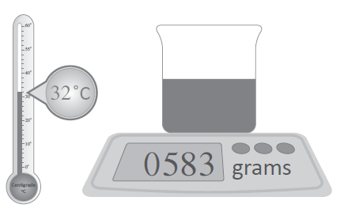
A glass container holding cold water below was placed on the digital scales after being moved from a 24º C room into a 32ºC room. The glass had collected 3 grams of water (through a process called condensation) on the outside for every 2 degree rise in room temperature. What was the original mass of the water filled glass if 24 grams of water was spilt during the move?
How can we simplify this question to make it easier to answer?

Slide 2
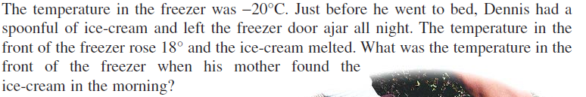
Topic : Worded Questions
24
7
30
Date
EQ : How do we answer worded Questions?
C - Circle the numbers in the question
U - Underline the question
B - Box the keywords
E - Eliminate the unnecessary information
S - Solve the question with working out
What is C.U.B.E.S?
-20ºC + 18ºC = -2ºC
The freeze was -2ºC in the morning

Slide 3
Let’s try and use CUBES on these questions…..
Jill is climbing up a steep and slippery path to fetch a bucket of water. When she is 6 m above her starting point, she slips back 1 m, grasps some bushes by the side of the path and climbs 7 m more to a flat section. How far above her starting point is she when she reaches the resting place?
One day Matt started with no money and was given $40. He spent $14 of it downloading music. What is his overall change of money on this day?

Slide 4
A glass container holding cold water below was placed on the digital scales after being moved from a 24º C room into a 32ºC room. The glass had collected 3 grams of water (through a process called condensation) on the outside for every 2 degree rise in room temperature. What was the original mass of the water filled glass if 24 grams of water was spilt during the move?
Okay, lets try this one again.

